Slide 1
CHAPTER 10 Graphs
10.1 Graphs and Graph Models
10.2 Graph Terminology and Special Types of Graphs
10.3 Representing Graphs and Graph Isomorphism
10.4 Connectivity
10.5 Euler and Hamilton Paths
10.6 Shortest Path Problems
10.7 Planar Graphs
10.8 Graph Coloring

Slide 2
Homework: (Due on May 20)
Sec. 10.4 27(e), 28, 29, 62
Homework: (Due on May 20)
Sec. 10.5 4, 6, 31, 34, 38, 41

Slide 3
10.4 Connectivity
1. Paths
A path of length n in a simple graph is a sequence of vertices v₀, v₁, . . . , v_{n} such that {v₀, v₁} , {v₁, v₂} , ..., {v _{n-1}, v_{n}} are n edges in the graph.
The path is a circuit if it begins and ends at the same vertex (length greater than 0).
A path is simple if it does not contain the same edge more than once.

Slide 4
10.4 Connectivity
Note:
There is nothing to prevent traversing an edge back and forth to produce arbitrarily long paths. This is usually not interesting which is why we define a simple path.
The notation of a path: vertex sequence
A path of length zero consists of a single vertex.

Slide 5
10.4 Connectivity
Path in directed graph
A path of length n in a directed graph is a sequence of vertices v₀, v₁, . . . v_{n} such that (v₀, v₁) , (v₁, v₂) , ..., (v_{n-1}, v_{n}) are n directed edges in the graph.
Circuit or cycle : the path begins and ends with the same vertex.
Simple path: the path does not contain the same edge more than once.

Slide 6
10.4 Connectivity
Paths represent useful information in many graph models.
〖Example 1〗Path in Acquaintanceship Graphs
In an acquaintanceship graph there is a path between two people if there is a chain of people linking these people, where two people adjacent in the chain know one other.
Many social scientists have conjectured that almost every pair of people in the world are linked by a small chain of people, perhaps containing just five or fewer people.
The play Six Degrees of Separation by John Guare is based on this notion.

Slide 7
9.4 Connectivity
2. Counting paths between vertices
The number of paths between two vertices in a graph can be determined using its adjacency matrix.

Slide 8




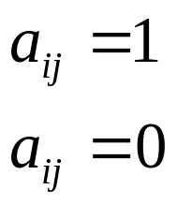
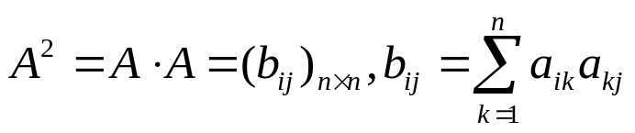

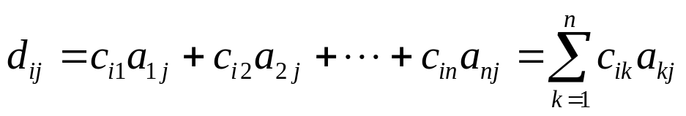
9.4 Connectivity
【 Theorem 2】 The number of different paths of length r from
v_{i} to v_{j} is equal to the (i, j)th entry of A^{r}, where A is the
adjacency matrix representing the graph consisting of vertices
v₁, v₂, . . . v_{n}.
Note: This is the standard power of A, not the Boolean product.
Proof:
Let
(3)
b_{ij}: the number of different paths of length 2
from v_{i} to v_{j}

Slide 9
10.4 Connectivity
v₄
〖Example 2〗
v₁
v₂
v₅
v₆
v₃
How many paths of length 2 are there from v₅ to v₄?
a₅₄ in A²: 1
(2) The number of paths not exceeding 6 are there from v₄ to v₅?
a₄₅ in A+A²+A³+A⁴+A⁵+A⁶ : 2
(3) The number of circuits starting at vertex v₅ whose length is not exceeding 6?

Slide 10
10.4 Connectivity
3. Connectedness in undirected graphs
An undirected graph is called connected if there is a path between every pair of distinct vertices of the graph.
〖Example 3〗 Are the following graphs connected?
a
b
a
b
e
e
d
d
c
c
No.
Yes.

Slide 11
10.4 Connectivity
【 Theorem 1】 There is a simple path between every pair of
distinct vertices of a connected undirected graph.
Proof:
Because the graph is connected there is a path between u and v. Throw out all redundant circuits to make the path simple.

Slide 12
10.4 Connectivity
The maximally connected subgraphs of G are called the connected components or just the components.
For example,
i
h
d
a
e
g
b
c
f
j

Slide 13
10.4 Connectivity
A vertex is a cut vertex (or articulation point), if removing it and all edges incident with it results in more connected components than in the original graph.
Similarly if removal of an edge creates more components the edge is called a cut edge or bridge.
For example,
（1）
In the star network the center vertex is a cut vertex.
All edges are cut edges.

Slide 14
10.4 Connectivity
（2）
There are no cut edges or vertices in the graph G above.
Removal of any vertex or edge does not create additional components.

Slide 15
10.4 Connectivity
4. Connectedness in directed graphs
A directed graph is strongly connected if there is a path from a to b and from b to a for all vertices a and b in the graph.
The graph is weakly connected if the underlying undirected graph is connected.
Note: By the definition, any strongly connected directed graph is also weakly connected.

Slide 16
10.4 Connectivity
For example,
a
a
b
b
d
d
c
c
Weakly connected
Strongly connected

Slide 17
10.4 Connectivity
For directed graph, the maximal strongly connected subgraphs are called the strongly connected components or just the strong components.
For example,
a
b
c
e
d
Problems:
How to determine whether a given directed graph is strongly connected or weakly connected ?
How to find the strongly connected components in a directed graph ?

Slide 18
10.4 Connectivity
5. Paths and Isomorphism
Idea:
Some other invariants
  The number and size of connected components
  Path
  Two graphs are isomorphic only if they have simple circuits of the same length.
  Two graphs are isomorphic only if they contain paths that go through vertices so that the corresponding vertices in the two graphs have the same degree.
We can also use paths to find mapping that are potential isomorphism.

Slide 19
10.4 Connectivity
〖Example 4〗 Are these two graphs isomorphic?
Solution:
No.
Because the right graph contains circuits of length 3, while the left graph does not.

Slide 20
Homework: (Due on May 20)
Sec. 10.4 27(e), 28, 29, 62

Slide 21
CHAPTER 10 Graphs
10.1 Graphs and Graph Models
10.2 Graph Terminology and Special Types of Graphs
10.3 Representing Graphs and Graph Isomorphism
10.4 Connectivity
10.5 Euler and Hamilton Paths
10.6 Shortest Path Problems
10.7 Planar Graphs
10.8 Graph Coloring

Slide 22
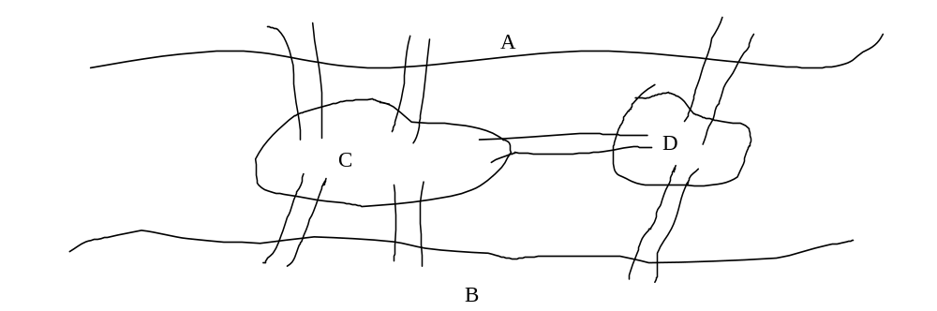
10.5.1 Euler Paths
9.5.1 Euler Paths
1. Konigsberg Seven Bridge Problem
Problem: Is it possible to start at some location in the town, travel across all the bridges without crossing any bridge twice, and return the starting point?
A
The question becomes: Is there a simple circuit in this multigraph that contains every edge?
C
D
B

Slide 23
10.5.1 Euler Paths
Terminologies:
Euler Path
An Euler path is a simple path containing every edge of G.
Euler Circuit
An Euler circuit is a simple circuit containing every edge of G.
Euler Graph
A graph contains an Euler circuit.

Slide 24
10.5.1 Euler Paths
2. Necessary and sufficient conditions for Euler circuit and paths
【 Theorem 1】 A connected multigraph has an Euler circuit
if and only if each of its vertices has even degree.
Proof:
Necessary condition
G has an Euler circuit ⇒ Every vertex in V has even degree
Consider the Euler circuit.
  the vertex a which the Euler circuit begins with
  intermeidate vertices

Slide 25
10.5.1 Euler Paths
(2) sufficient condition
We will form a simple circuit that begins at an arbitrary vertex a of G.
  Build a simple circuit x₀=a, x₁, x₂,…,x_{n}=a.
  An Euler circuit has been constructed if all the edges have been used. otherwise,
  Consider the subgraph H from G by deleting the edges already uses and vertices that are not incident with any remaining edges.
  Let w be a vertex which is the common vertex of the circuit and H.
  Beginning at w, construct a simple path in H.

Slide 26
10.5.1 Euler Paths
【 Theorem 2】 A connected multigraph has an Euler path
but not an Euler circuit if and only if it has exactly two vertices
of odd degree.
〖Example 1〗 Konigsberg Seven Bridge Problem
A
C
D
B
Solution:
1. The graph has four vertices of odd degree. Therefore, it does not have an Euler circuit.
2. It does not have an Euler path either.

Slide 27
10.5.1 Euler Paths
〖Example 2〗 Determine whether the following graph has an Euler path. Construct such a path if it exists.
B
The Euler path:
A,C,E,F,G,I,J,E,A,B,C,D,E,G, H,I,G,J
C
A
J
D
E
I
F
G
H
Solution:
The graph has 2 vertices of odd degree, and all of other vertices have even degree . Therefore, this graph has an Euler path.

Slide 28
10.5.1 Euler Paths
3. Euler circuit and paths in directed graphs
A directed multigraph having no isolated vertices has an Euler circuit if and only if
-- the graph is weakly connected
-- the in-degree and out-degree of each vertex are equal.
A directed multigraph having no isolated vertices has an Euler path but not an Euler circuit if and only if
-- the graph is weakly connected
-- the in-degree and out-degree of each vertex are equal for all but two vertices, one that has in-degree 1 larger than its out-degree and the other that has out-degree 1 larger than its in-degree.

Slide 29
10.5.1 Euler Paths
〖Example 3〗 Determine whether the directed graph has an Euler path. Construct an Euler path if it exists.
a
b
c
d
Solution:
 | deg⁻(v) | deg⁺(v)
a | 1 | 2
b | 2 | 2
c | 2 | 2
d | 3 | 2
Hence, the directed graph has an Euler path.

Slide 30
10.5.1 Euler Paths
〖Example 3〗 Determine whether the directed graph has an Euler circuit. Construct an Euler circuit if it exists.
a
b
c
d
Solution:
 | deg⁻(v) | deg⁺(v)
a | 1 | 2
b | 2 | 2
c | 2 | 2
d | 3 | 2
Hence, the directed graph has an Euler path.

Slide 31
10.5.1 Euler Paths
4. Applications
Euler path or circuit can be used to solve many practical problems.
1) A type of puzzle
Draw a picture in a continuous motion without lifting a pencil so that no part of the picture is retraced.
The equivalent problem: Whether the graph exist an Euler path or circuit.
For example,

Slide 32
10.5.1 Euler Paths
4. Applications
Euler path or circuit can be used to solve many practical problems.
2) The Chinese postman problem
- The problem is named in honor of Guan Meigu, who posed it in 1962.
3) The other area, such as networking, molecular biology etc.

Slide 33
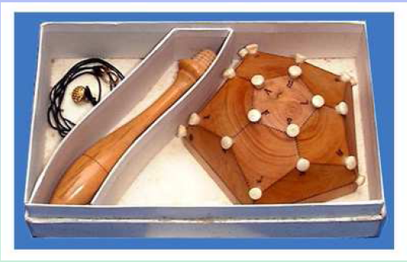
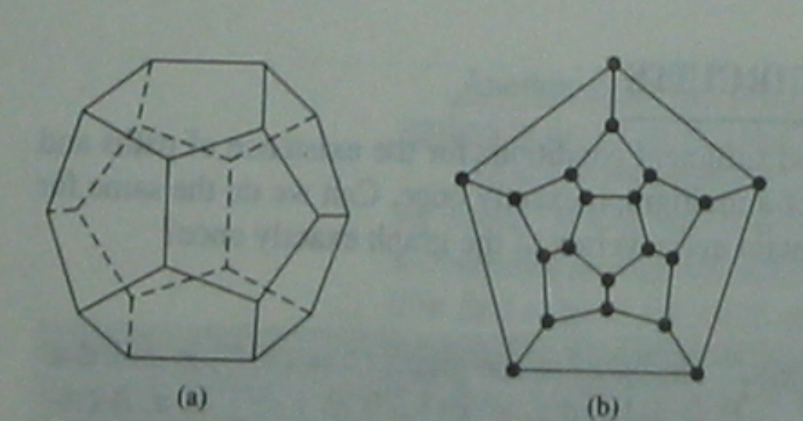
10.5.2 Hamilton paths and circuit
9.5.2 Hamilton paths and circuit
Hamilton’s puzzle
The object of the puzzle was to start at a city and travel along the edges of the dodecahedron(20边形), visiting each of the other 19 cities exactly once, and end back at the first city.
The equivalent question: Is there a circuit in the graph shown in b that passes through each vertex exactly once?

Slide 34
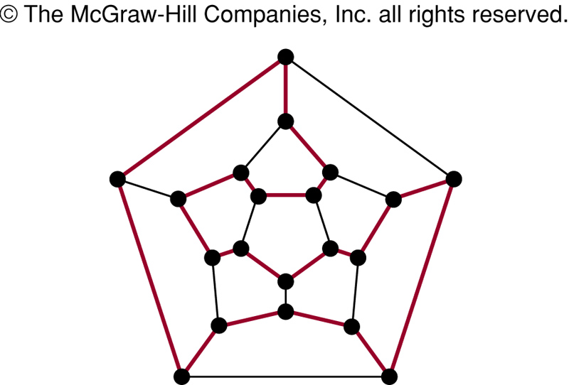
10.5.2 Hamilton paths and circuit

Slide 35
10.5.2 Hamilton paths and circuit
A Hamilton path in a graph G is a path which visits every vertex in G exactly once.
A Hamilton circuit (or Hamilton cycle) is a cycle which visits every vertex exactly once, except for the first vertex, which is also visited at the end of the cycle.
If a connected graph G has a Hamilton circuit, then G is called a Hamilton graph.

Slide 36

10.5.2 Hamilton paths and circuit
1. The sufficient condition for the existence of Hamilton path and Hamilton circuit
【 Theorem 3】 DIRAC' THEOREM （狄拉克定理）
If G is a simple graph with n vertices with n>=3 such that the
degree of every vertex in G is at least n/2, then G has a Hamilton
circuit.
【 Theorem 4】ORE' THEOREM
If G is a simple graph with n vertices with n>=3 such that
deg(u)+deg(v) >= n for every pair of nonadjacent vertices
u and v in G , then G has a Hamilton circuit.
边足够多

Slide 37
10.5.2 Hamilton paths and circuit
〖Example 4〗 Show that K_{n} has a Hamilton circuit whenever n>=3 ?
For example,
Proof:
We can form a Hamilton circuit in K_{n} beginning at any vertex. Such a circuit can be built by visiting vertices in any order we choose, as long as the path begins and ends at the same vertex and visits each other vertex exactly once. This is possible since there are edges in K_{n} between any two vertices.

Slide 38
10.5.2 Hamilton paths and circuit
2. The necessary condition for Hamilton path and Hamilton circuit
For undirected graph:
The necessary condition for the existence of Hamilton path:
  G is connected;
  There are at most two vertices which degree are less than 2.

Slide 39
10.5.2 Hamilton paths and circuit
2. The necessary condition for Hamilton path and Hamilton circuit
The necessary condition for the existence of Hamilton circuit:
  The degree of each vertex is larger than 1.
  Some properties:
  If a vertex in the graph has degree two, then both edges that are incident with this vertex must be part of any Hamilton circuit.
  When a Hamilton circuit is being constructed and this circuit has passed through a vertex, then all remaining edges incident with this vertex, other than the two used in the circuit , can be removed from consideration.

Slide 40
10.5.2 Hamilton paths and circuit
Another important necessary condition
For any nonempty subset S of set V, the number of connected components in G-S <=|S|.
Note:
G-S is a subgraph of G
Suppose that C is a H circuit of G. For any nonempty subset S of set V, the number of connected components in C-S <=|S|.
(3) the number of connected components in G-S <= the number of connected components in C-S

Slide 41
10.5.2 Hamilton paths and circuit
〖Example 5〗 Does the following graphs have a Hamilton circuit?
Another important necessary condition
For any nonempty subset S of set V, the number of connected components in G-S <=|S|.

Slide 42
10.5.2 Hamilton paths and circuit
3. Applications
Hamilton path or circuit can be used to solve many practical problems also.
For example,
1) Find a path or circuit that visits each road intersection in a city, or each node in a communication network exactly once.
2) The famous traveling salesman problem (TSP)
3) ……

Slide 43
10.5.2 Hamilton paths and circuit
〖Example 6〗 There are seven people denoted by A, B, C, D, E, F, G. Suppose that the following facts are known.
    A--English (A can speak English.)
    B--English, Chinese
    C--English, Italian, Russian
    D--Japanese, Chinese
    E--German, Italia
    F--French, Japanese, Russian
    G--French, German
How to arrange seat for the round desk such that the seven people can talk each other?

Slide 44
10.5.2 Hamilton paths and circuit
Solution:
Construct graph
V={A,B,C,D,E,F,G}, E={(u,v)|u,v can speak at least one common language.}
    A--English (A can speak English.)
    B--English, Chinese
    C--English, Italian, Russian
    D--Japanese, Chinese
    E--German, Italia
    F--French, Japanese, Russian
    G--French, German
G
B
A
A
F
D
C
B
E
F
D
C
E
G
(2) If there is a H circuit, then we can arrange seat for the round desk such that the seven people can talk each other.
H circuit: A,B,D,F,G,E,C,A

Slide 45
Homework: (Due on May 20)
Sec. 10.5 4, 6, 31, 34, 38, 41
8th, 7th

